Slide 1
HCSC Idea-a-thon Presentation Template

Slide 2
Predicting high cost users next year's costs & classify risks for appropriate intervention programs
OPPORTUNITY / IDEA
RATIONALE
BENEFITS
Describe the scope of the project:​
Identify the different member's segments based on costs & medical variables on the historical data.​
Predict high cost users in the immediate future year and their total costs and classify their risks to identify the member population for different intervention programs.
What is business need or pain points? ​
High cost users contribute to majority of healthcare costs. By identifying the high cost users total costs, classify their risks for the immediate future year and taking appropriate intervention programs like wellness, disease management & case management programs, costs can be effectively managed and controlled, provide appropriate care & efficiently allocate resources & improve health outcomes
What is the risk of not doing?​
Unmanaged costs​
Inefficient allocation of resources
Forecast total costs & manage healthcare budgets ​
Improved utilization of resources​
Implement measures to prevent patients from ​becoming high cost users​
Provide appropriate care​
Recommend patients to different intervention ​programs like wellness, disease management & ​case management programs.
What is changing or retained
This is a new implementation
SOLUTION HIGHLIGHTS
ESTIMATE/COST
Data sources considered : Member Demographics, Clinical data (Labs & EMR), Utilization data, Medical inpatient, outpatient, pharmacy claims, dental claims & vision claims, Health risk assessment data​
Volume of data : Previous years (atleast 2 years)​
Data Preparation: ​
Identify potentially relevant variables from all the identified data sources.​
Merge & dedupe the data as needed for modeling​
Perform missing value imputation & convert all the categorical variables to binary or do one hot encoding to transform them.​
Perform dimensionality reduction technique to reduce the number of variables.​
Build a unsupervised clustering model to cluster the member segments based on costs, risks and other variables and identify top 5%-7% high cost users from low cost users and label the cost outcome as high, medium & low.​
Build supervised regression models to learn from the data to predict total costs for the immediate future year.​
Build a supervised classification model to classify the high cost members.​
Segregate the chronically ill patients from one time high cost patients based on different clusters and recommend members for different intervention programs; wellness, disease management & case management ​
| © 2018 Cognizant

Slide 3












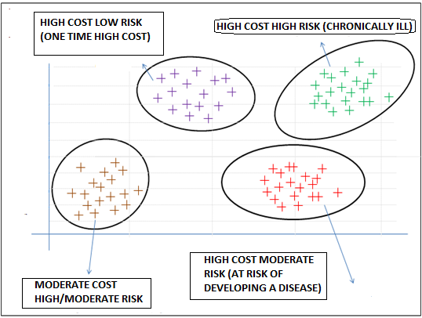

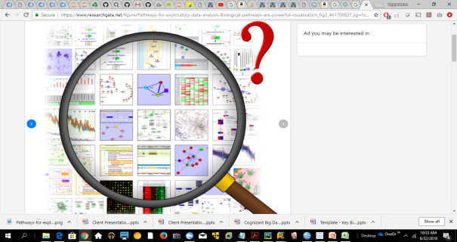








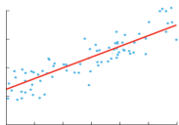

Solution Architecture
Source Systems
HCSC - Data lake
Membership
Raw Layer
Data Processing
Gold Layer
Data Processing
Consumption Layer
Rest APIs / Web Service
Membership
Demographics
Claims &utilization
Medical, Pharmacy
Vision, Dental
Claims &utilization
Analytic data Store
Clinical
Clinical
Lab, EMR
Others
Health Risk Assessement Data
Health Risk Assessment Data
Data Management, Scheduling, Security & Auditing
Data Science Platform
Stratify Members
Case Management program
Dimensionality Reduction - PCA
Model building, Evaluation & Optimization
Clustering
Uncover Underlying relationships,
distribution in the sample dataset,
identify trends, patterns, deviations & outliers
Transform variables, treat outliers and anomalies
Reduce Dimensions
High Cost
Disease Management program
Low Cost
Classification
Wellness Programs
Regression
Predict cost

